Slide 1
Autonomous Subway Inspection Vehicle
Phase
6
Senior Design
Omar Aziz, Noah Bolzoni, Brandon Castro,
Anthony Lucero, Sean Maggio, Marcin Wisniowski
Advised By Professor Connington
May 7th, 2020

Slide 2
Outline
Modeling
Demo
A
B
1
2
3
4
Overview
Technical Analysis
Engineering Design
Moving Forward

Slide 3
Overview
1

Slide 4
Project Overview
Autonomous vehicle to collect key track data
More frequent, non-intrusive inspections
Increase subway revenue, efficiency, and safety
4

Slide 5
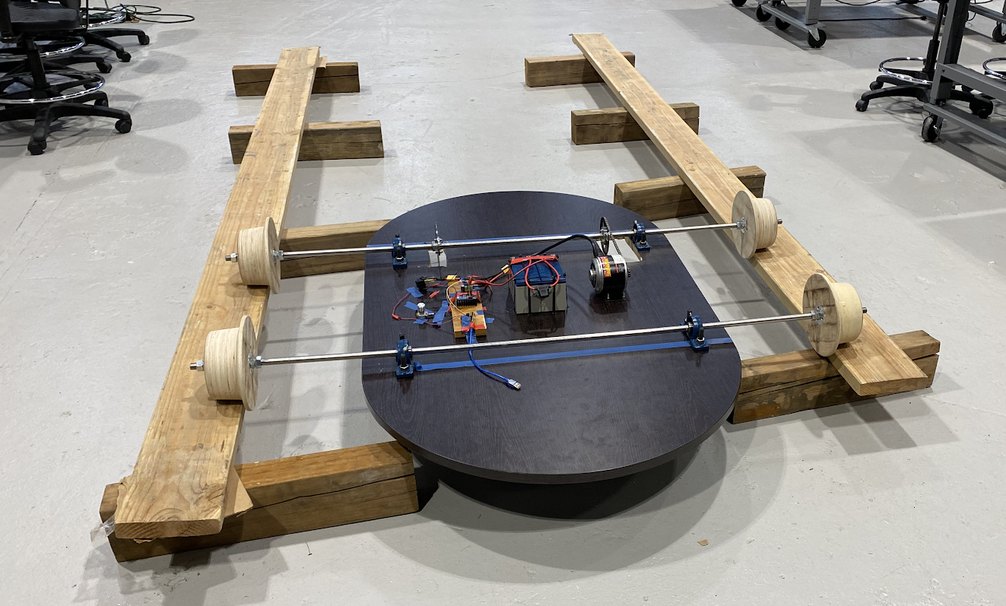
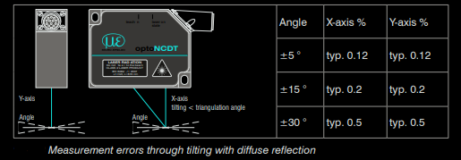
Overview - Alpha
Powertrain prototype
Straight line testing of vehicle
Measurement prototype
Incline testing
5

Slide 6
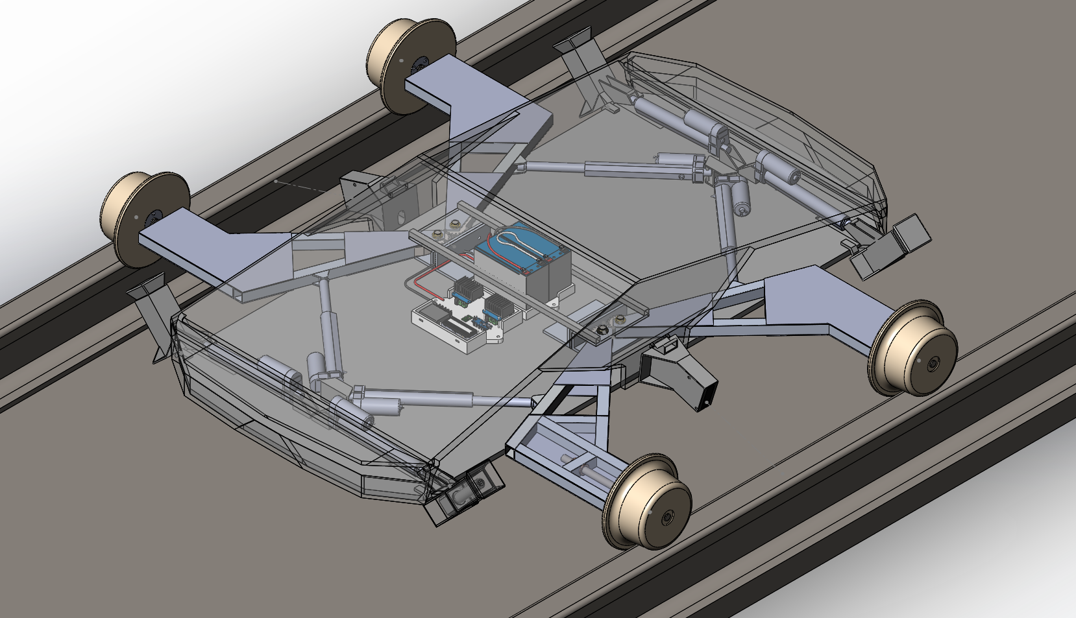
Overview - Beta
CAD model of beta prototype
Calculated vehicle dynamics on curved track
6

Slide 7
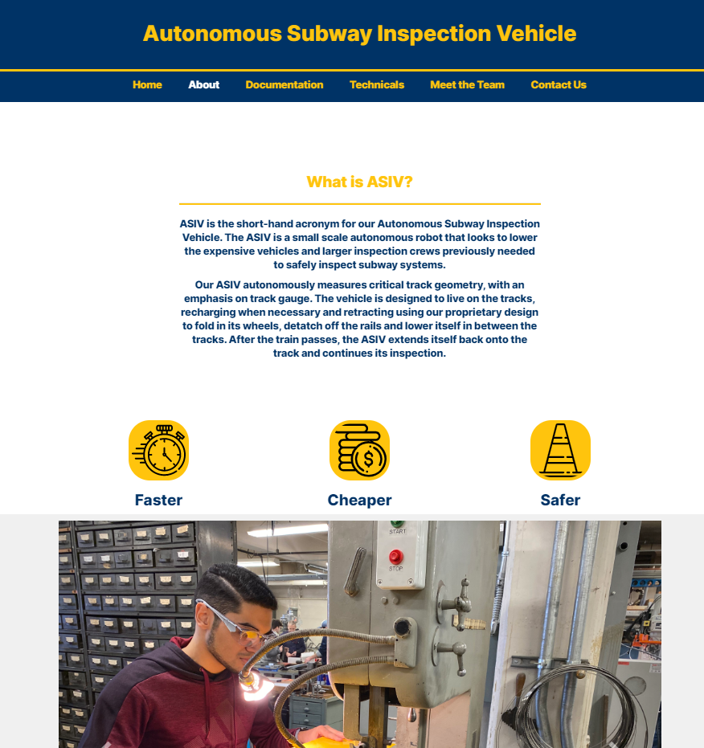
Website Design
Worked on creating a central hub to find and share information with interested parties and Expo members
Created a visual identity for the onTrack team and made work publicly available on the website: ontrackasiv.tk
Allows for a visual element to our project and all the work we have done to be shared with future employers or on our resume.
7

Slide 8
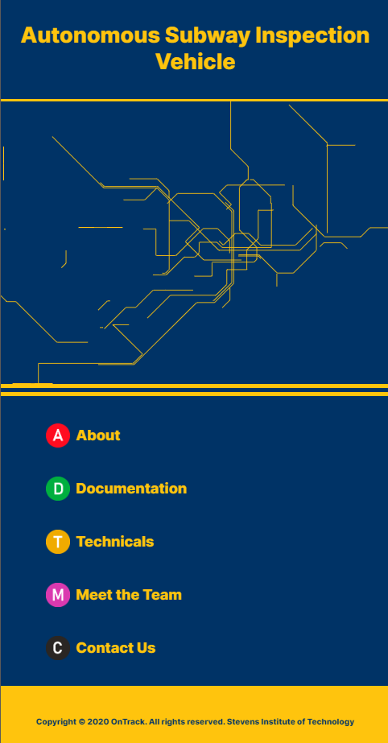
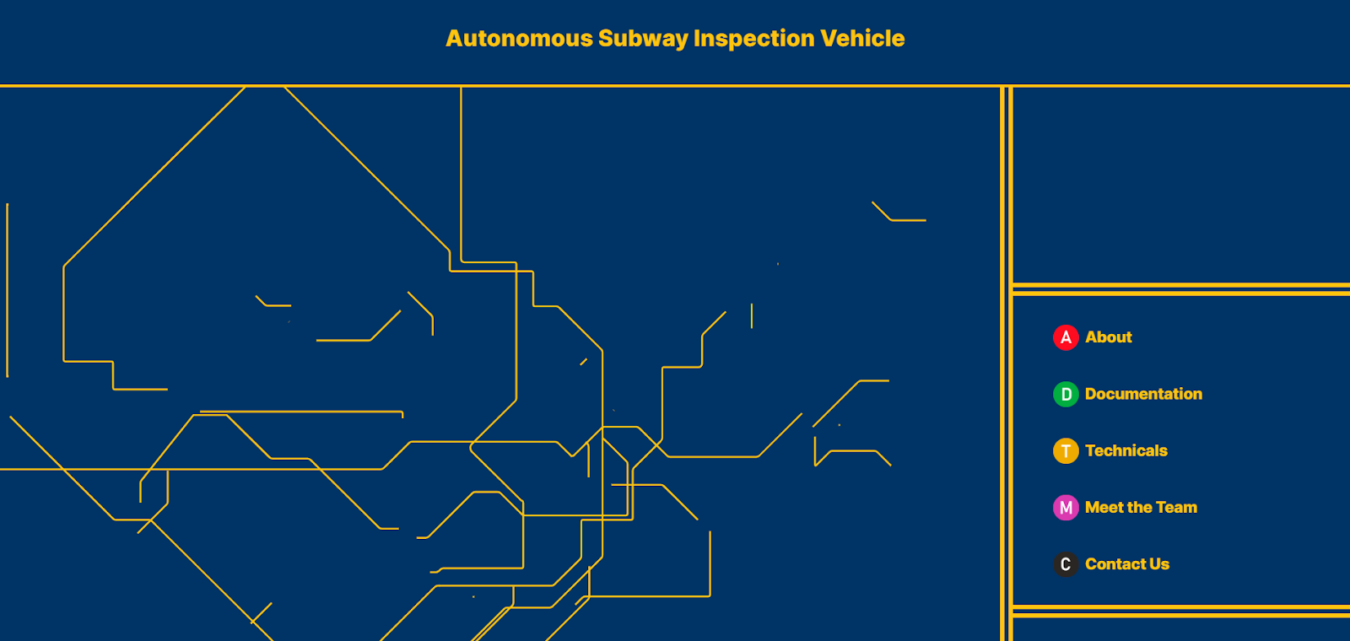
Website Design
Custom-built mobile-friendly design in CSS and HTML to differentiate ourselves from the rest of the groups that built with pre-made google sites templates
8

Slide 9
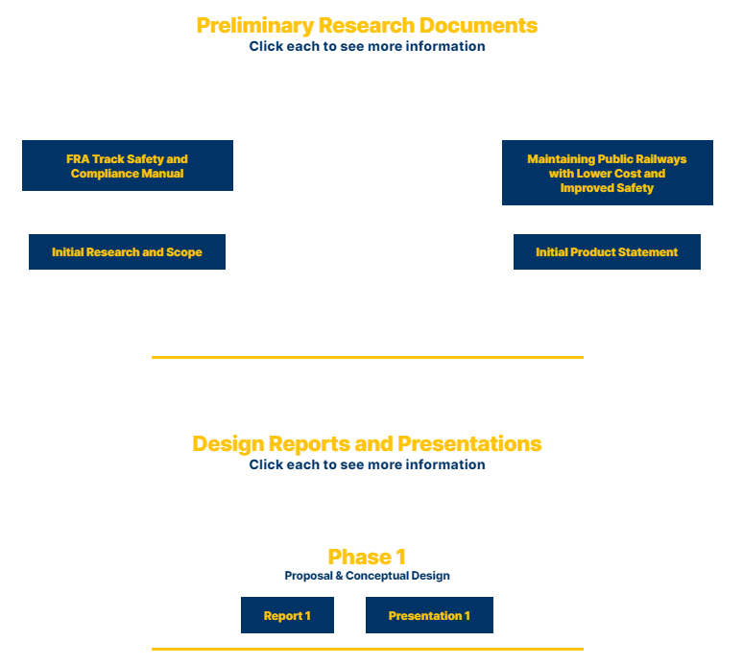
Website Design
GitHub hosted file system to allow the group to upload and link to technical documents within the site
Updated regularly to keep up with work done on reports and presentations
9

Slide 10
Technical Analysis
2

Slide 11
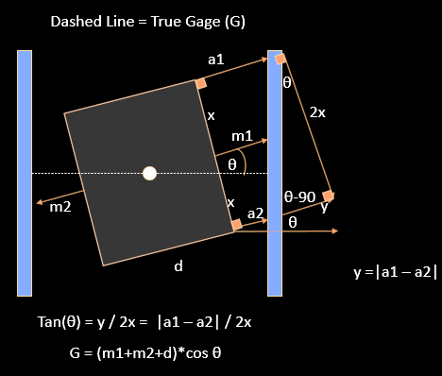
Proof for Rotation on Z-Axis
The vehicle will tend to twist at an angle with respect to the centerline of the tracks when navigating curves.
Two additional proximity sensors will measure from the body of the vehicle to one rail. (illustrated as “a1” and “a2”)
The difference in measurement between the two sensors can be used to determine the angle of twist.
11

Slide 12
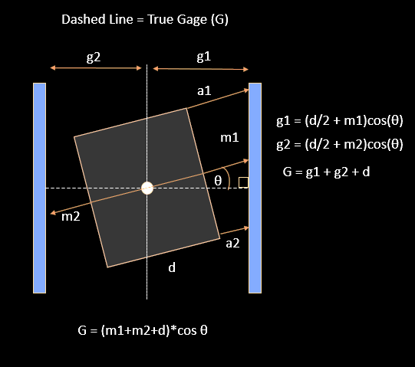
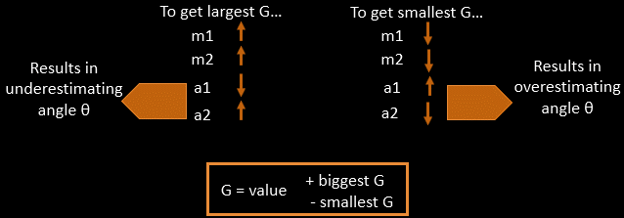
Proof for Rotation on Z-Axis
The measured value of gage is corrected to match the actual gage value by multiplying it by the cosine of the angle of twist.
12

Slide 13
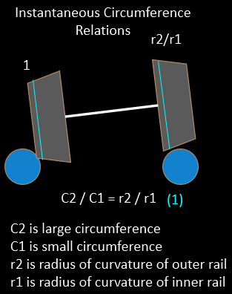
Proof for Rotation on X-Axis
The vehicle also twists at an angle with respect to the of the plane formed by the tops of the two rails.
An attempt to correct for resulting measurement error uses the circumferences of the wheels in contact with each rail.
13

Slide 14
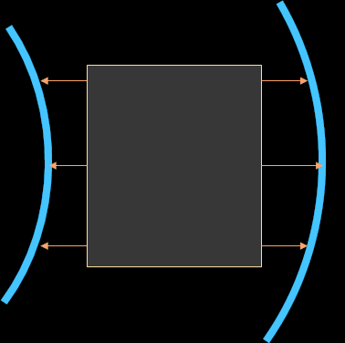
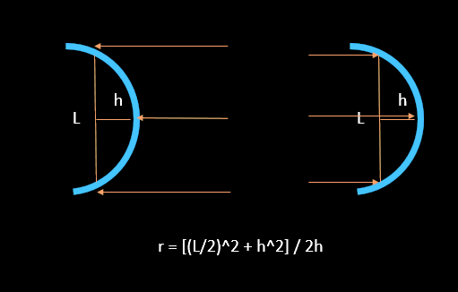
Proof for Rotation on X-Axis
This method would also require measurement of track curvature.
14

Slide 15
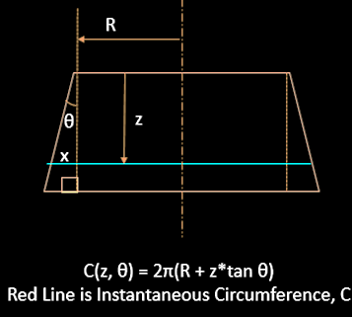
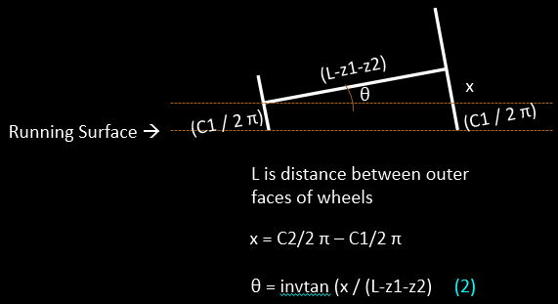
Proof for Rotation on X-Axis
Given the geometry of each wheel, tilt would be a function of curvature and instantaneous circumference of the wheels.
The problem with this is there are three unknowns, and only two equations.
The solution is to fix an unknown at its worst case and see whether the error is significant or negligible.
15

Slide 16
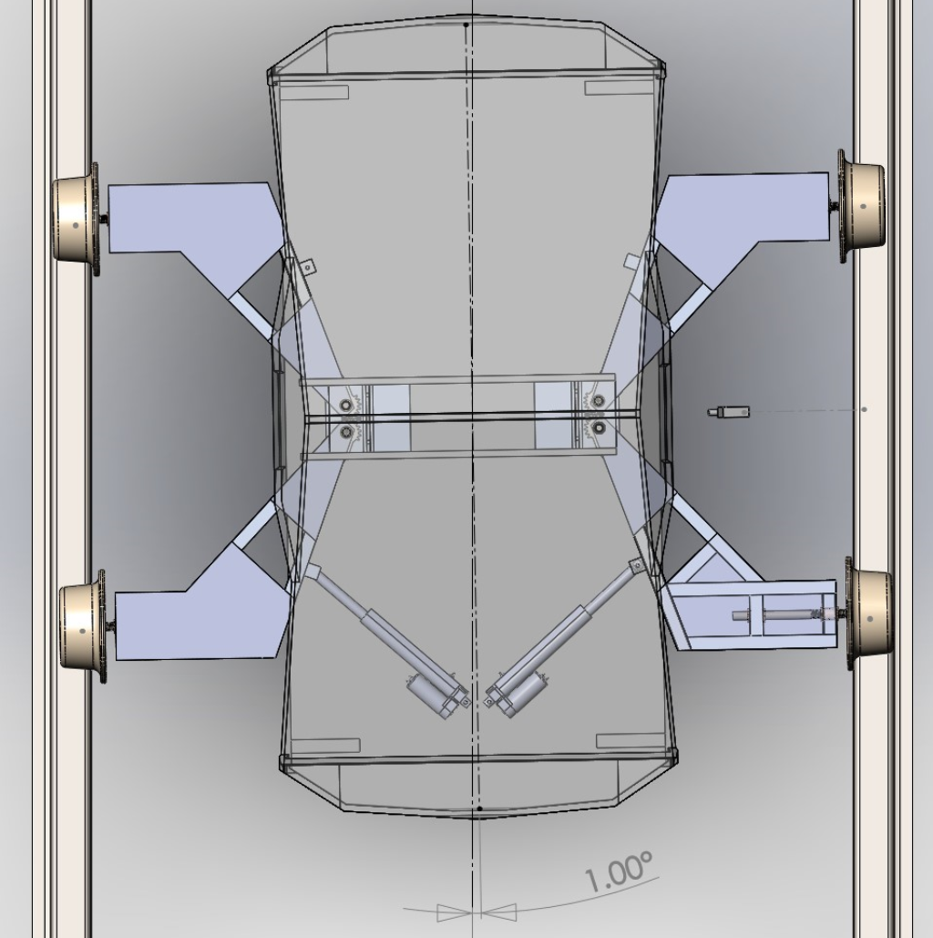
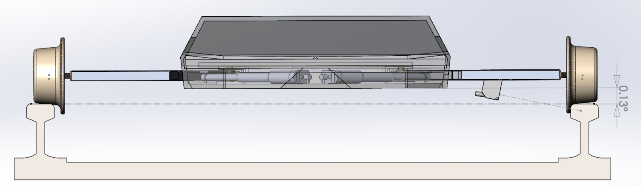
Analysis of Tilt Severity
Simulating contact between wheel flange and rail indicated that the max tilt values in the z-axis and x-axis were 1 degree and 0.13 degrees, respectively.
This results in a negligible variance between the measured gage value and the actual.
16

Slide 17
Electronics
Overall Goals:
“Animate” the chassis
Learn more about electronics and system architecture
Measure and record at least gauge (track width)
17

Slide 18
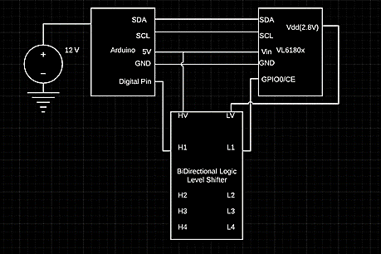
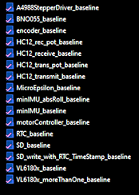
Electronic Design
Accomplished:
Individualized “guides” including circuits and basic code for each component
Overall system architecture
Example of individual component
A collection of “baseline” codes
18

Slide 19
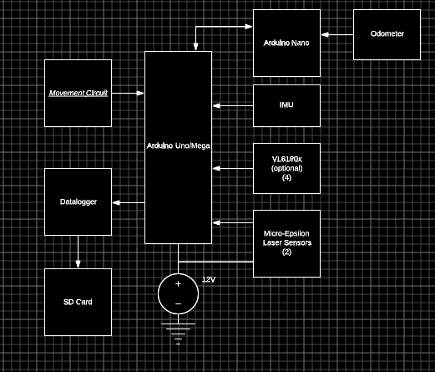
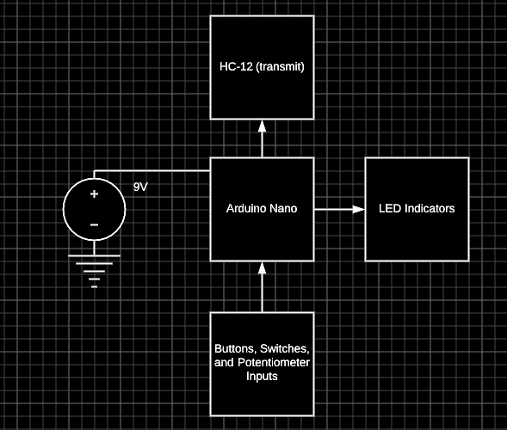
Overall Architecture
Measurement Circuit
Control Circuit
19

Slide 20
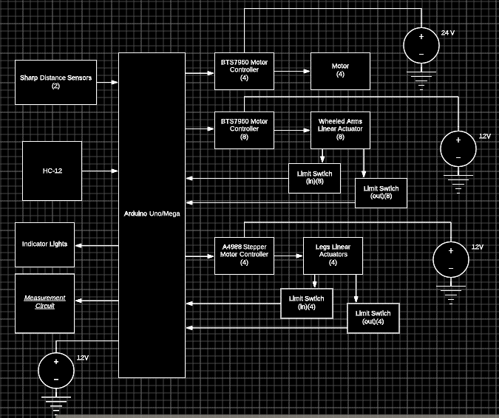
Overall Architecture
Movement/Central Circuit
20

Slide 21
Usage
Adjust speed and direction
Trigger evasion (and return to tracks)
Vehicle does not allow you to hit obstacles
Choose if measurement is on or off, and which measurements are taken
Possible outputs:
Timestamp, Odometry, Individual Distances, Gauge, roll angle, Calculated crosslevel
Ability to toggle between two modes
Measurements triggered by odometry
Press button to request measurement
21

Slide 22
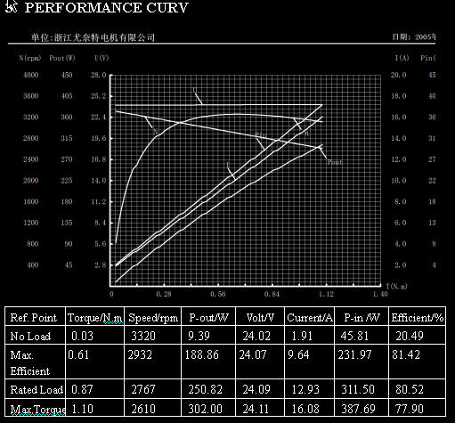
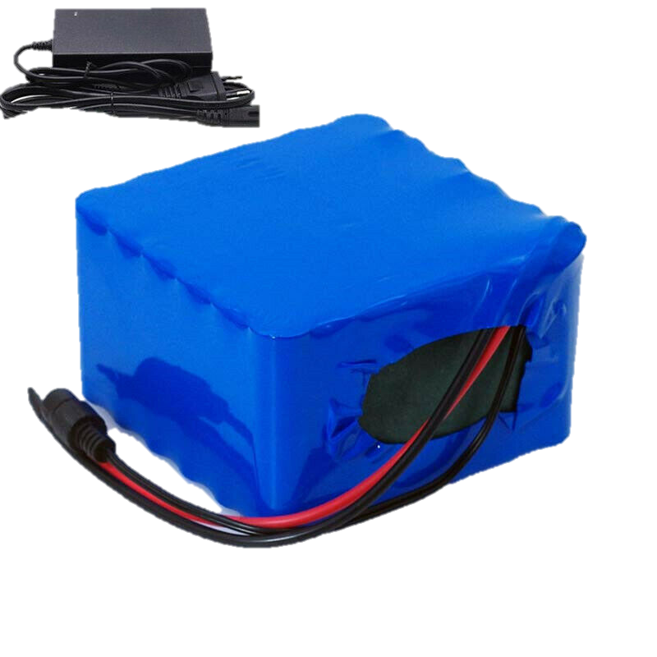
Finalized Motor Analysis
Future Testing Considerations:
Run unloaded tests on each motor with multimeter (find values such as internal resistance)
Inclined track with appropriately weighted vehicle to test configuration with four motors
Run motors with 18 Ah battery to confirm calculated range of ~40 miles (4 hours of running at 10 mph) before recharge
22
25.2V18AH

Slide 23
Engineering Design
3

Slide 24
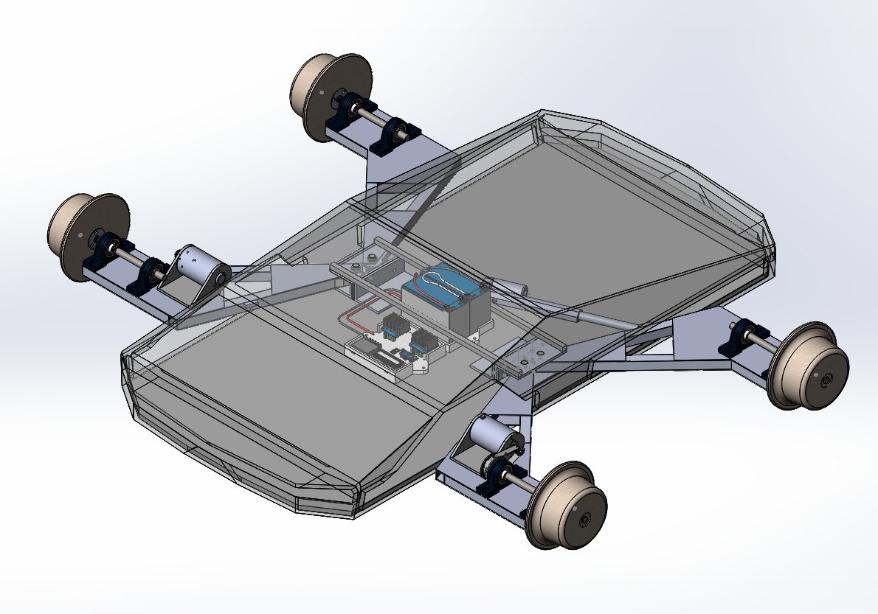
Beta Prototype
24

Slide 25
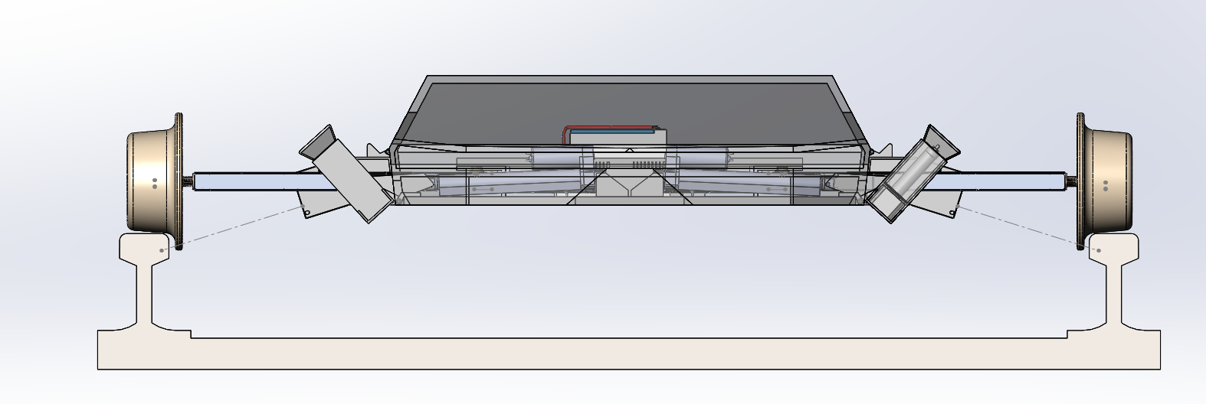
Front View
25

Slide 26
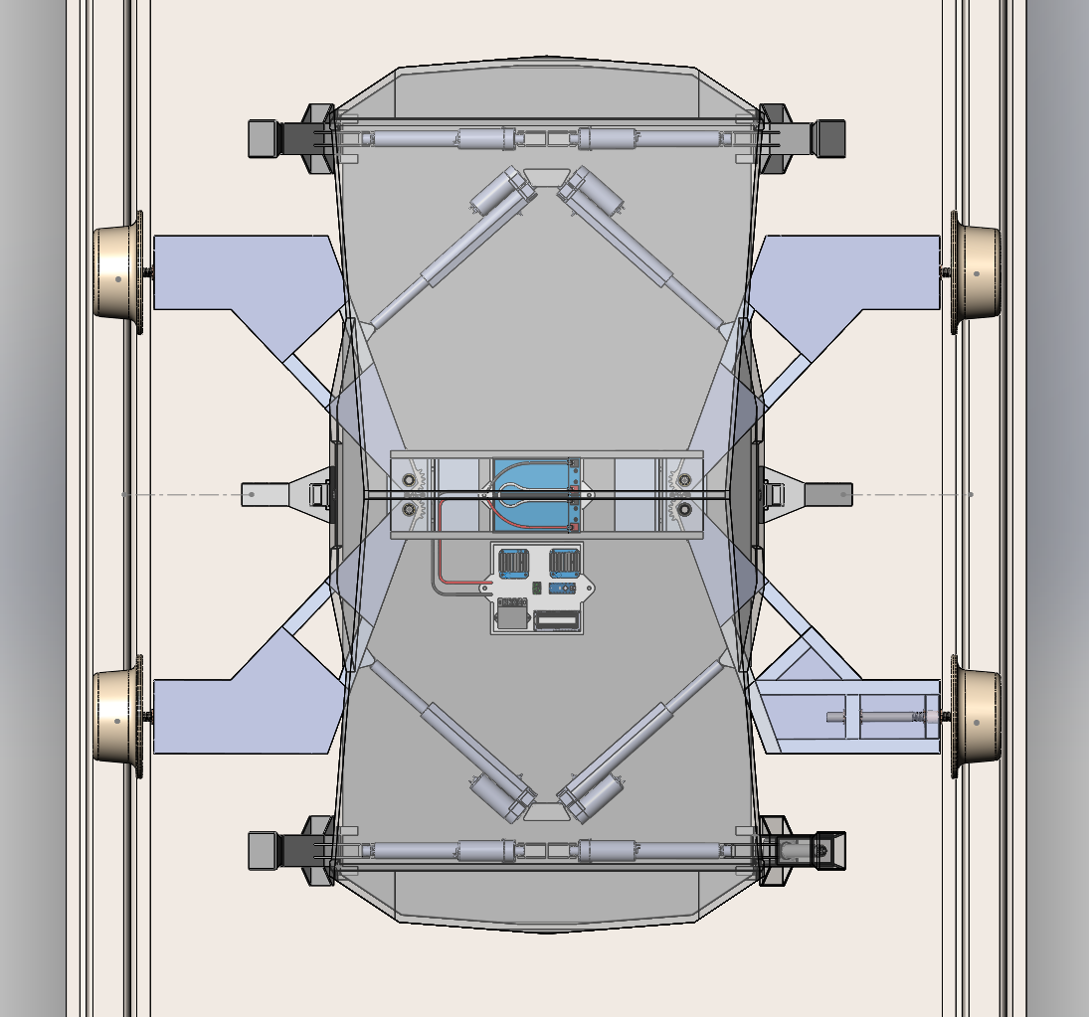
Top View
26

Slide 27
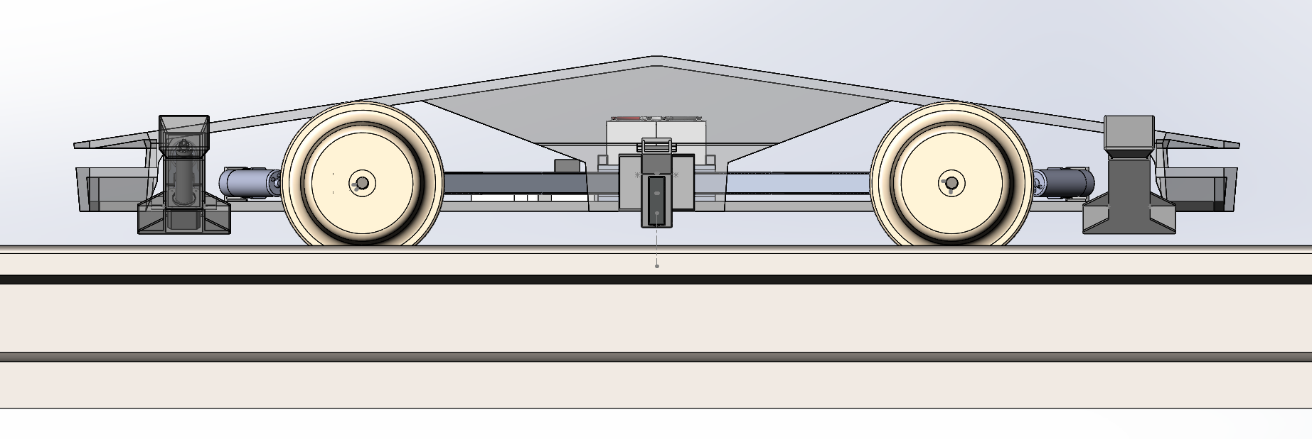
Side View
27

Slide 28
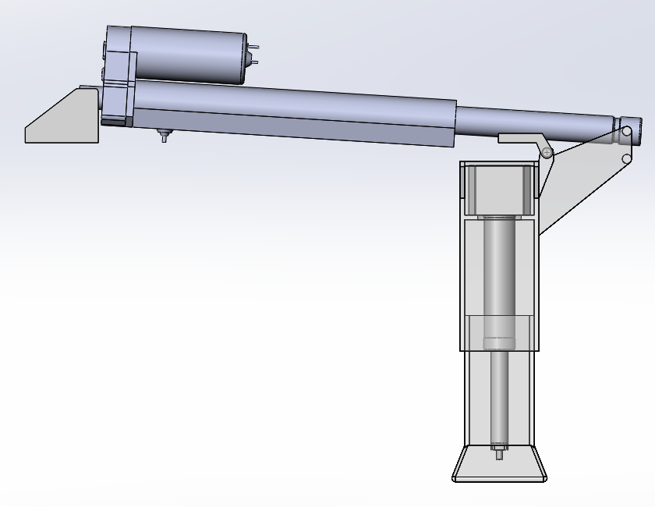
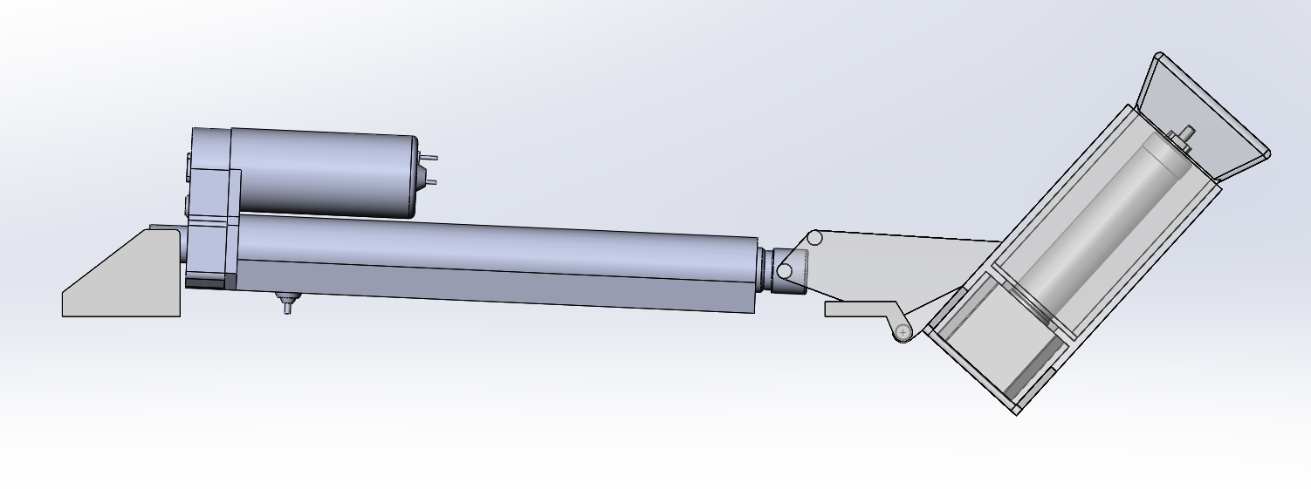
Landing Legs
Extended
Retracted
28

Slide 29
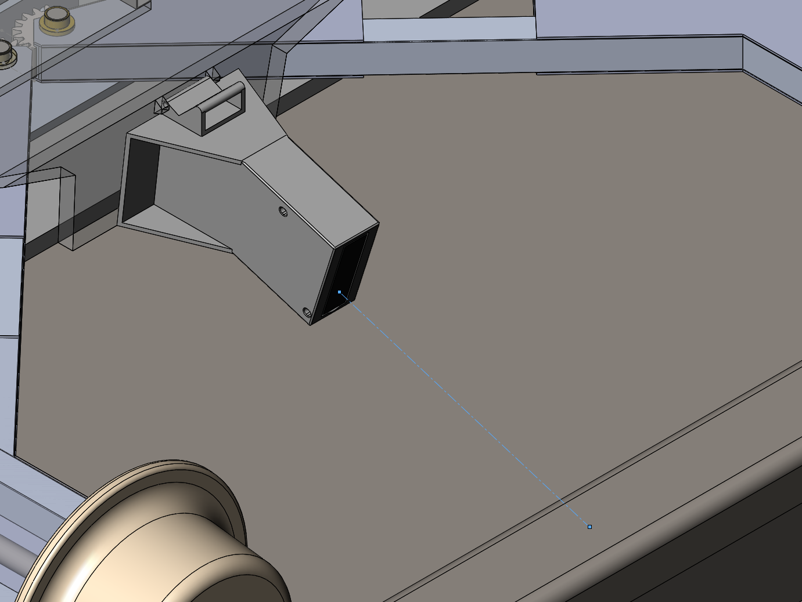
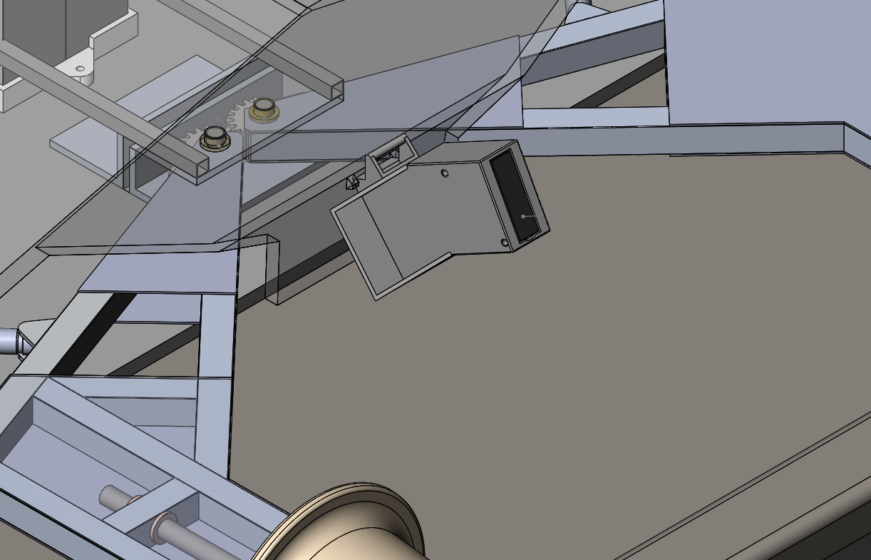
Sensor Mount
Extended
Retracted
29

Slide 30
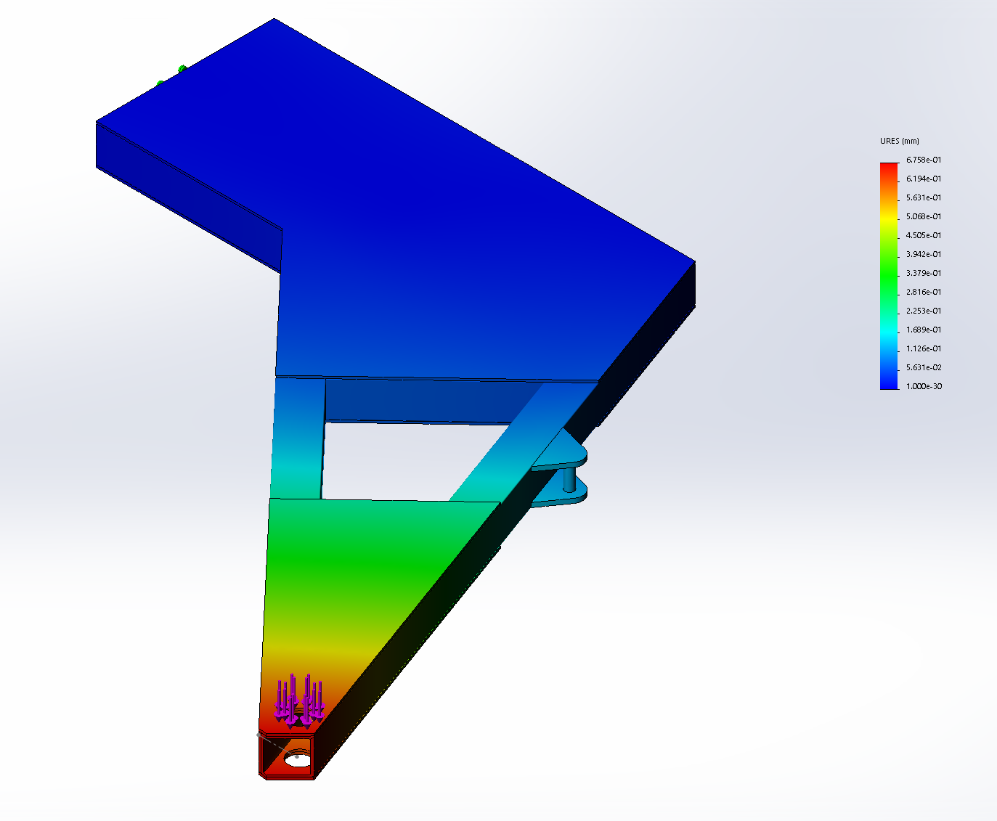
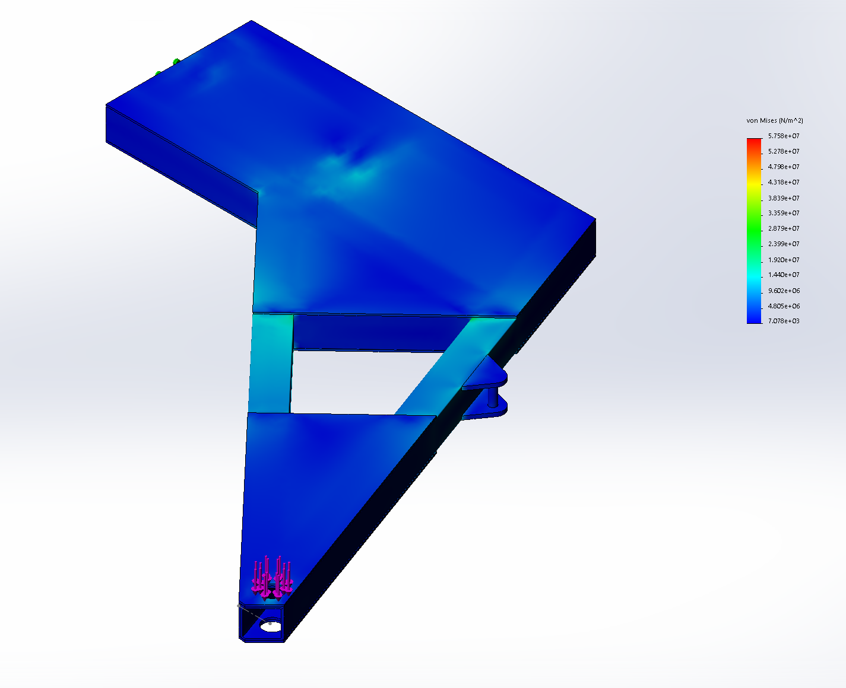
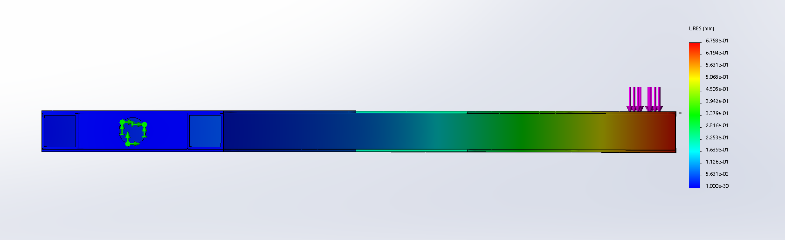
Stress Analysis
Stress (FOS: >4)
Displacement: ~7mm
30

Slide 31
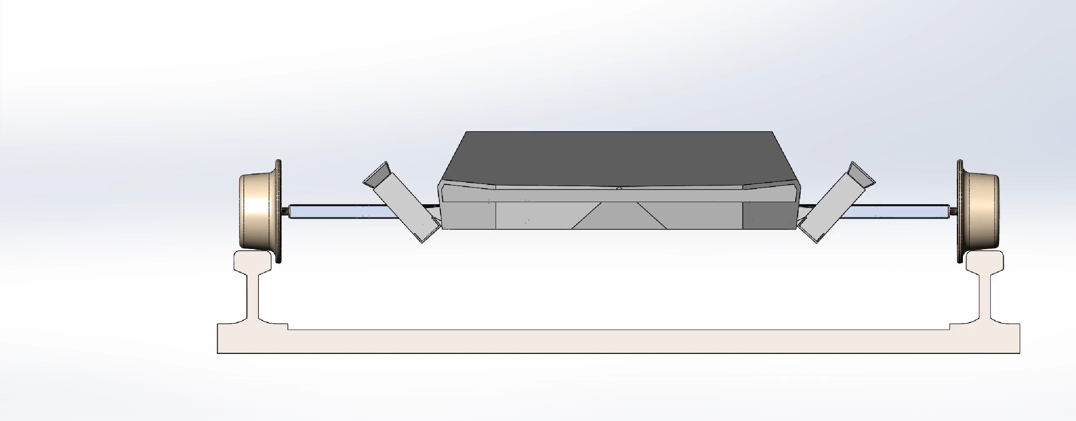
Retraction Demo
31

Slide 32
Moving Forward
4

Slide 33
Completed Deliverables
Transition to Virtual Prototype Development
Completion of Mechanical components
CAD model, layout, and drive mechanism
Completion of Electrical Components
Circuit diagram, code, and test values
Innovation Expo
33

Slide 34
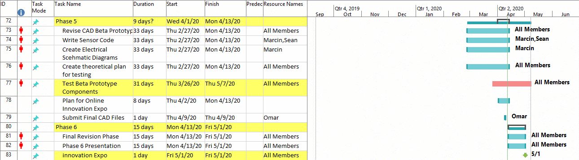
Timeline
34

Slide 35
Future Plans
Creation of a Physical Model
Creation of User Interface
Real World Testing and Implementation
Additional Key Track Parameter Measurements
35

Slide 36
Lessons Learned
Hard Skills
Learned various methods of machining and manufacturing
Systems architecture and integration
Learned how to manage and maintain a budget
In depth knowledge of subway systems and trains
Soft Skills
Working with other members on a long-term project
Have a clear consensus of the ideal vision for the project
Be prepared to proudly defend our ideas and ask for help
36

Slide 37
Lessons Learned
Odometry
Interrupt vs polling
3D space geometry (Euler)
IMU functionality
Motor driving and control
Organization
Government regulations
Tools
Circuitry software
Programming libraries and IDE (more in depth)
I2C communication
37

Slide 38
Appendix

Slide 39
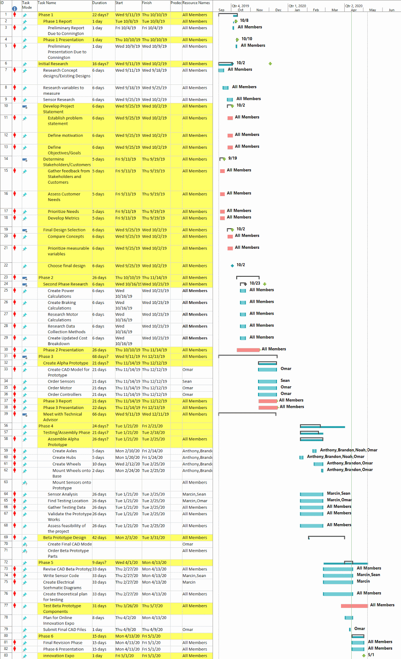
Gantt Chart

Slide 40
Gantt Chart

